Slide 1


TRIVIA NIGHT
benefitting

Slide 2

THE RULES
WE'RE PLAYING ON THE HONOR SYSTEM.
YOU WILL KEEP YOUR OWN SCORE.
USE THE CHAT BOX TO SEND YOUR SCORE AT THE END OF EACH ROUND.
NO GOOGLING!

Slide 3


ROUND 1

Slide 4



Slide 5


Slide 6



Slide 7


Slide 8



Slide 9



Slide 10



Slide 11



Slide 12



Slide 13


Slide 14

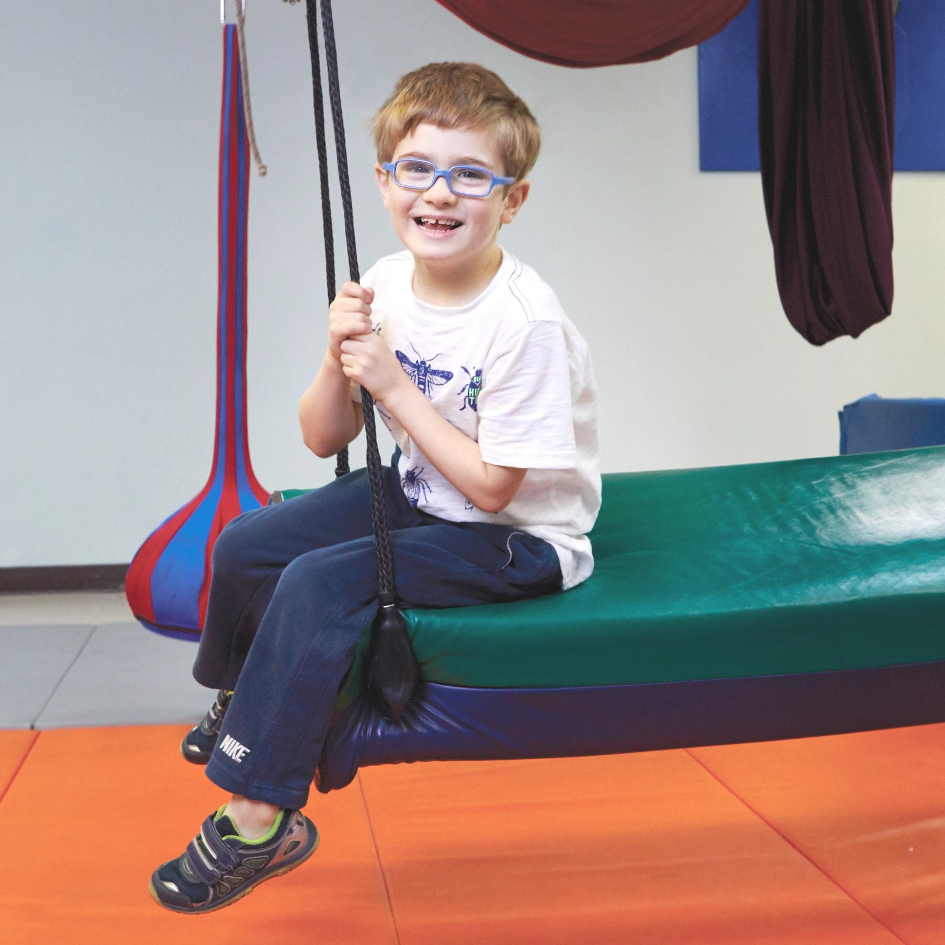

END OF ROUND 1
POST YOUR CORRECT # OF ANSWERS IN THE CHAT
The mission of the Autism Treatment Center is to
assist people with autism and related disorders throughout their lives as they learn, play, work and live in the community.
ATC is a private nonprofit providing its services 24 hours a day, 365 days a year. Services include residential, education, therapy, adult programs and research.
Learn more at www.atcoftexas.org

Slide 15


ROUND 2

Slide 16



Slide 18



Slide 19



Slide 20




Slide 21



Slide 22



Slide 23



Slide 24




Slide 25



Slide 26


END OF ROUND 2
POST YOUR CORRECT # OF ANSWERS IN THE CHAT
Autism is a developmental disability that can cause significant social, communication, and behavioral challenges.
Though there is no cure, early interventions can help reduce these challenges.
Learn more at www.atcoftexas.org

Slide 27

ROUND 3

Slide 28



Slide 29



Slide 30



Slide 31



Slide 32



Slide 33



Slide 34


Slide 35


Slide 36



Slide 38
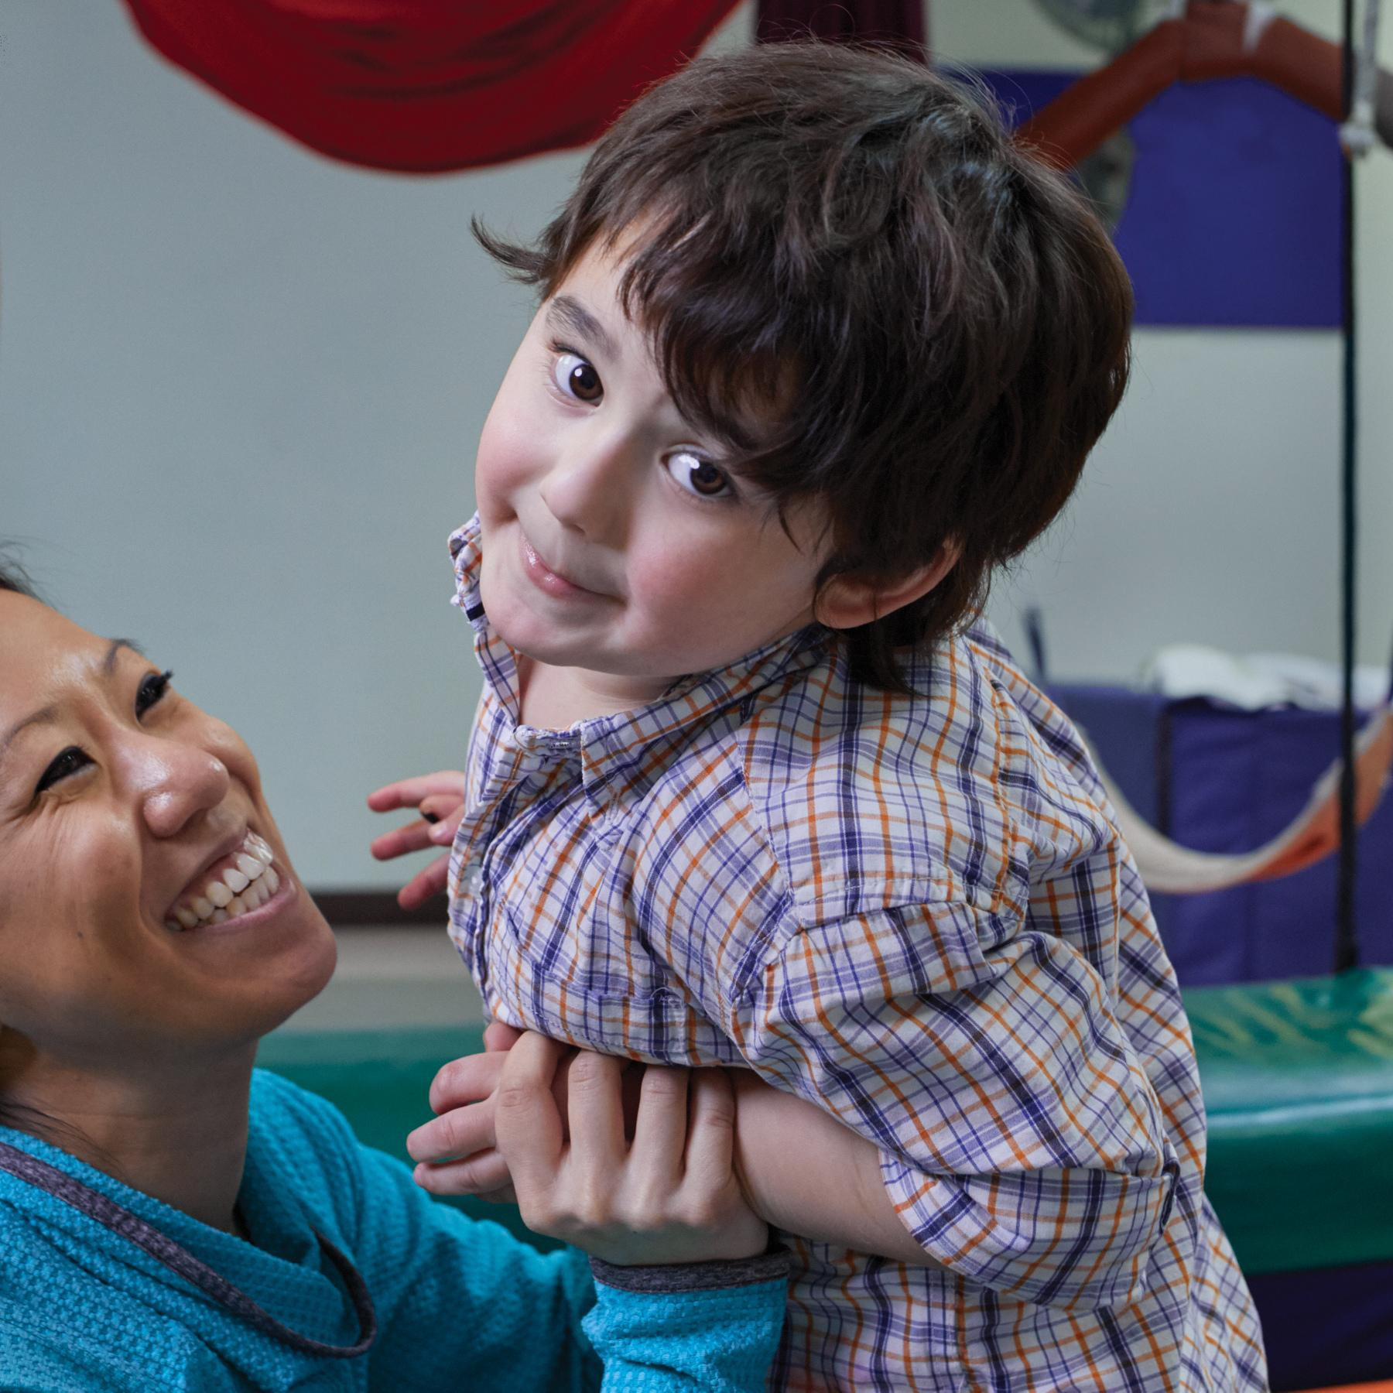

END OF ROUND 3
POST YOUR CORRECT # OF ANSWERS IN THE CHAT
1 in 54 children is diagnosed with autism.
Autism is more than 4 times more common among boys than girls.
Learn more at www.atcoftexas.org

Slide 39




AND THE WINNER IS...

Slide 40



www.atcoftexas.org

